Slide 1

SKILLBOOK
Personalized career plan for people in tech
Notes:
We are SkillBook
We create amazing personalized career plans for people in tech
In most countries there is virtually no carer advice, especially for women, especially in tech.

Slide 2
Data Science supply and demand in Switzerland
High supply
Low supply
Low demand
High demand
Source: datacareer.ch & Nitin Kumar, Propulsion Academy
Notes:
For example, this is a slide from yesterday’s tech talk from Nitin Kumar.
It shows that the hype for data science has been too successful.
However, there are careers like Data Engineering and DevOps where the demand is high and supply low.
And these careers have very similar skills to that of Data Scientists.
Which makes for an easy career transition.3

Slide 3

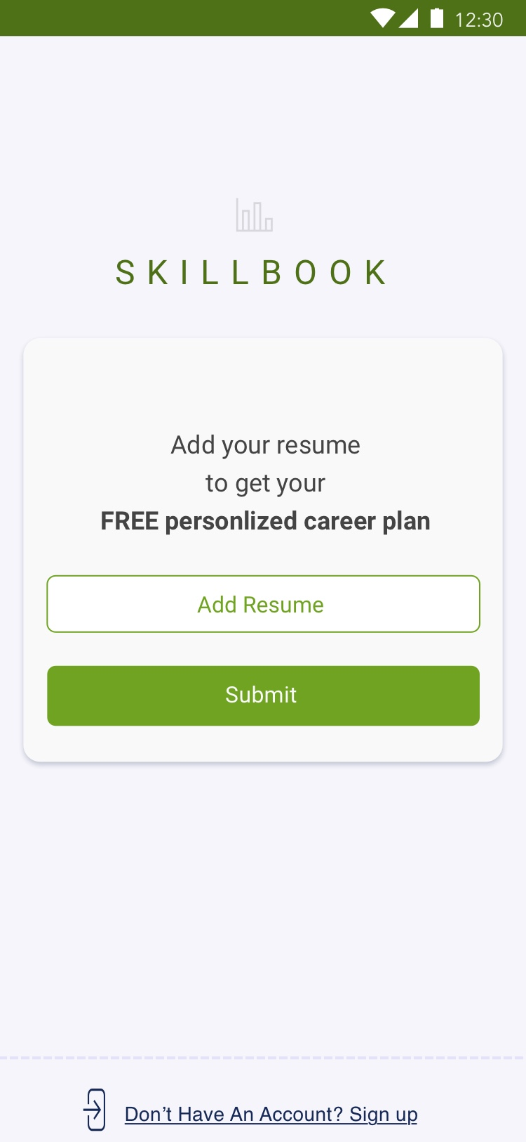
Notes:
That’s why we are developing SkillBook – an app for personalized career plans for people in tech
All you have to do is to upload your resume. It could be your PDF CV your Linkedin profile or just text.3

Slide 4
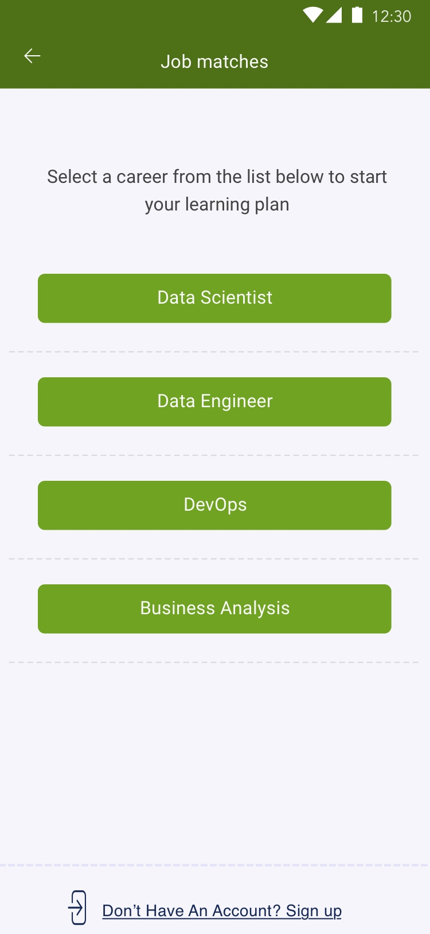
Notes:
Then, our NLP-based algorithms analyze your CV and identify your strengths and missing skills.
Based on that, we match you to a set of career paths.
We will incorporate other important aspects like
– projected fututure demand
-- including the risk of AI automation
Flexible work hours
Cost to transition

Slide 5
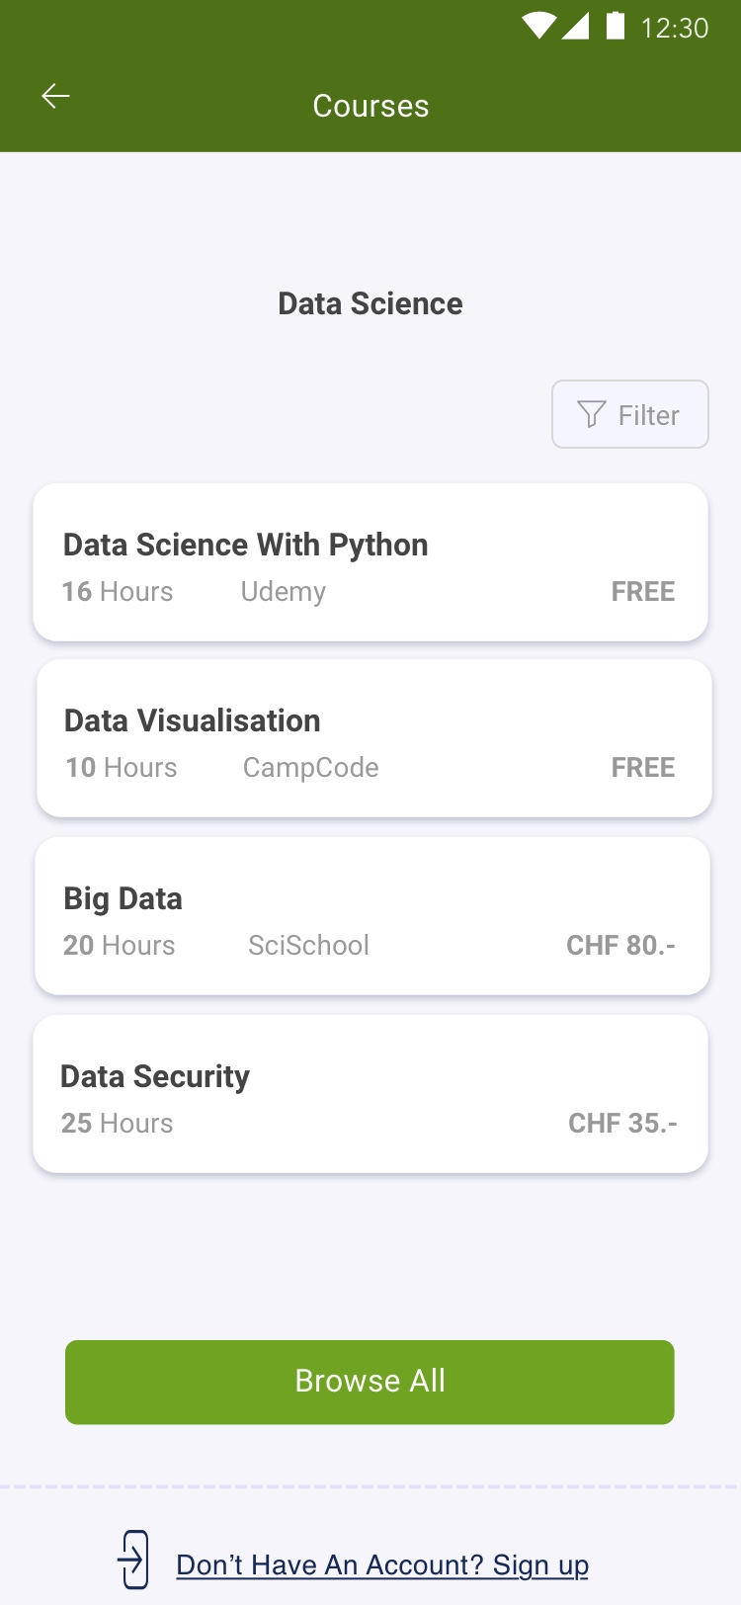
Notes:
For each career path, we provide a curated list of classes, optimized for the skills that will grow you career the most.

Slide 6




Competition
Low cost (or free)
SKILLBOOK
Low plan quality
High plan quality
High cost
Notes:
There are multiple competitors, but most of them are in 1-1 coaching space (like linkedin)

Slide 7
Business Model
Free for users
Commission from paid courses
Udemy: 40%, Propulsion Academy: 500 CHF
Enterprise-specific solutions
E.g. Accenture

Slide 8
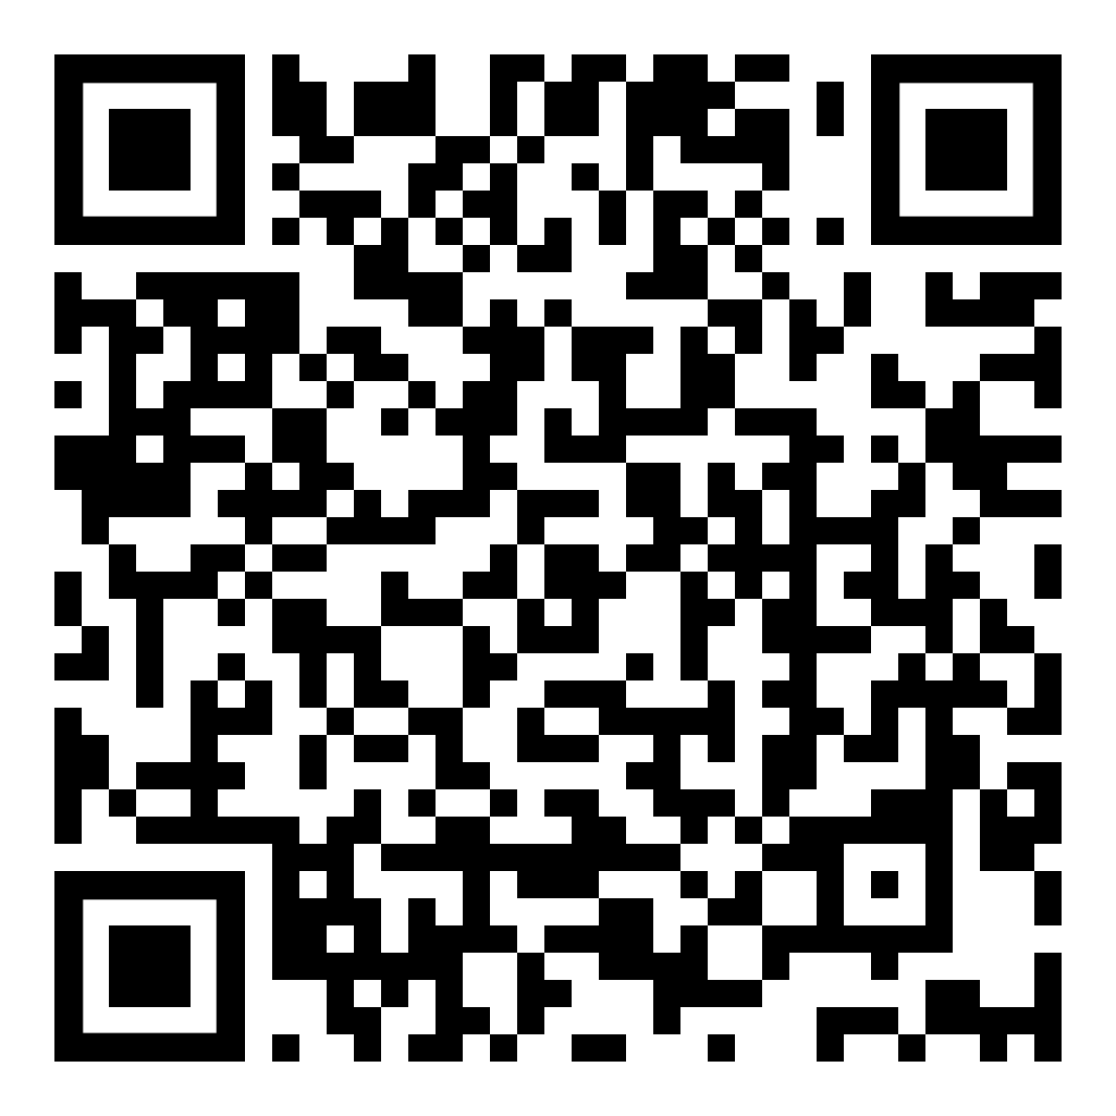
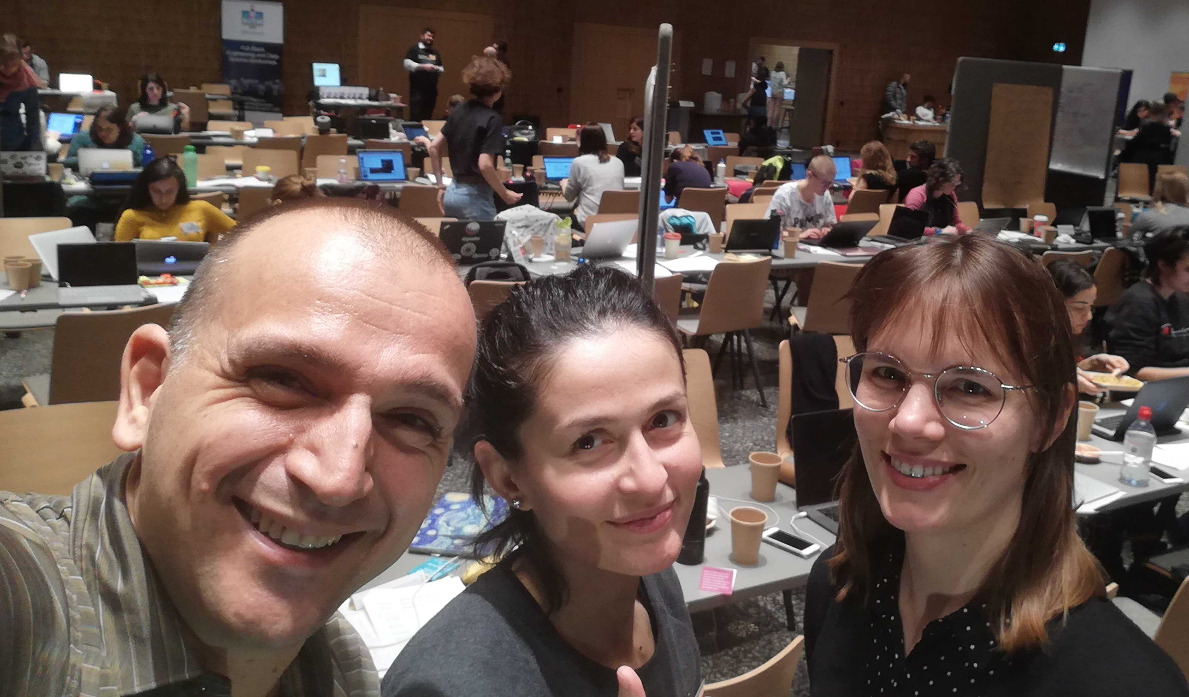

Try
SKILLBOOK
now
Mannar Hielal – App development
Laura Kyd – Research and presentation
Casey Paskalev – Business modeling
http://bit.do/skillbook Thank you <3

